Slide 1
Market update
System Intelligence

Slide 2
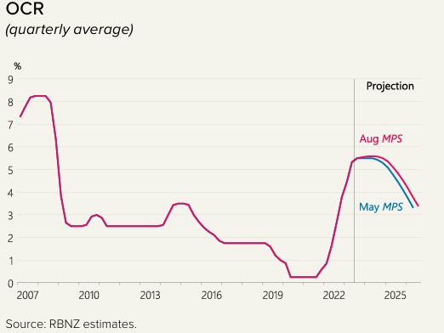
Economic outlook
Inflation rate is falling but still too high, sticky domestic inflation
Net migration is at record high
OCR may stay high for longer
Next indicators to look out for: wage inflation (Dec 2023) and CPI (Jan 2024)

Slide 3
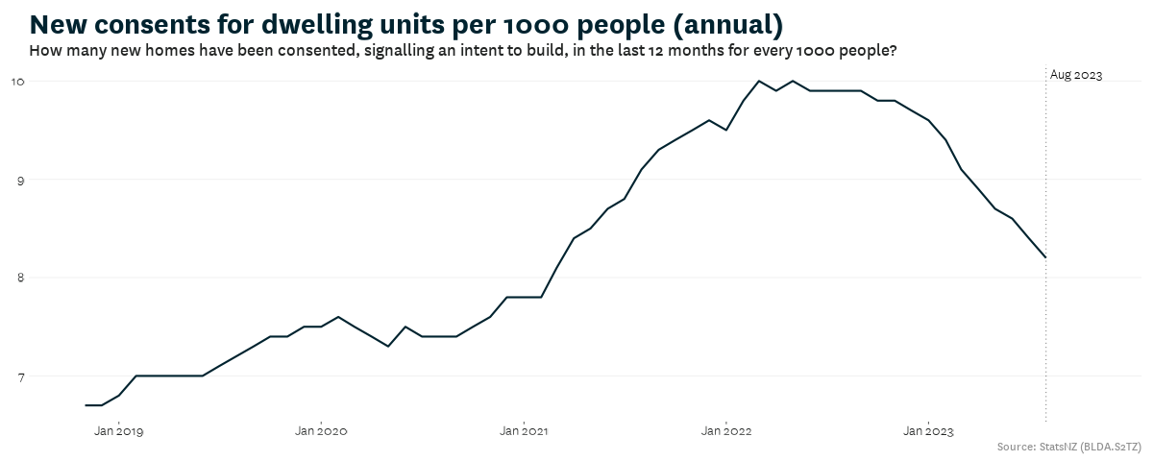
Construction sector
Consents continue to drop, and completion begins to slow
The lack of ‘pre-sales’ and challenging development economics
Kāinga Ora activity remains strong
There are risks that further downturn could lead to capacity loss in the sector

Slide 4
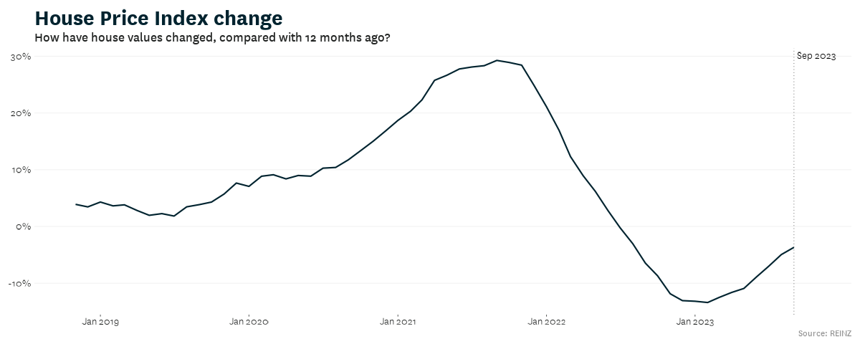
Property market
Some signs of recovery
FHBs remain active and investors maintain their market share
We do not expect a large surge due to the high cost of ownership
Home insurance premiums have increased, and insurers are retreating from some areas

Slide 5
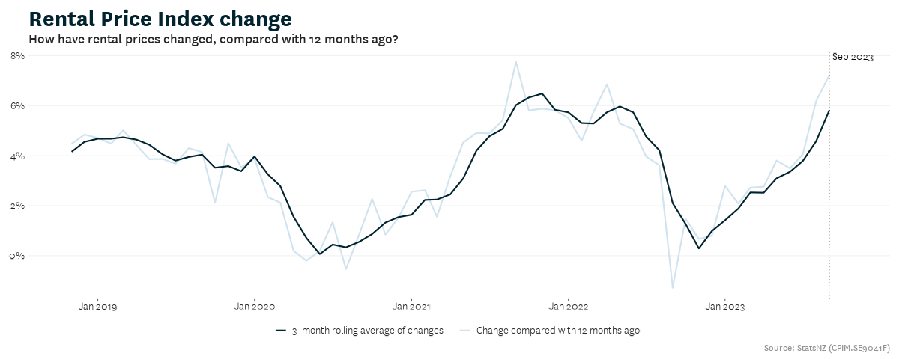
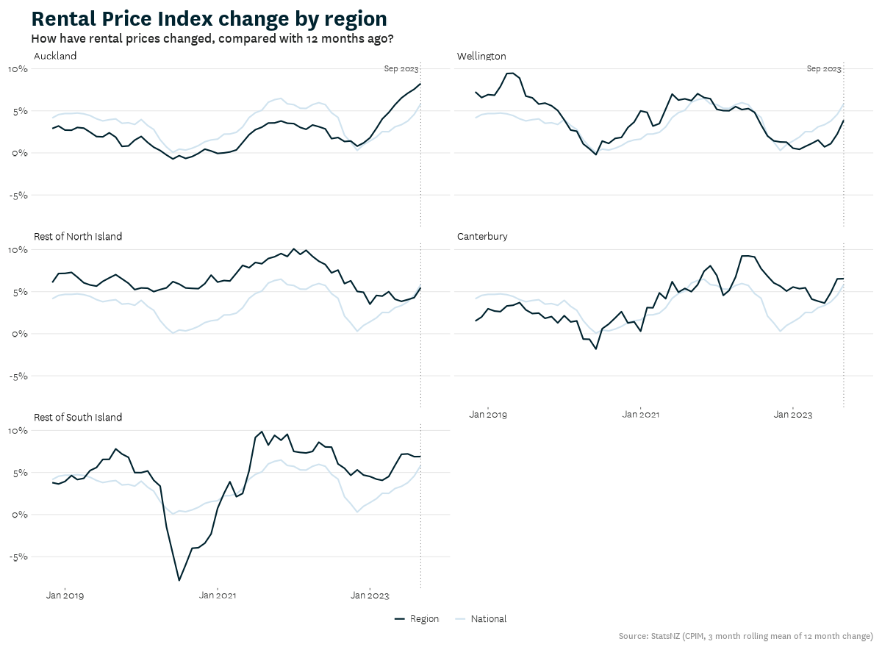
Rental market
High rental inflation, mainly driven by Auckland
High net migration is likely the key driver
Worsening affordability with high rents and softening wage growth
Investors’ confidence may improve with potential tax policy changes and high yield

Slide 6

What drives rents in New Zealand?
Joint research paper with Treasury and RBNZ

Slide 7
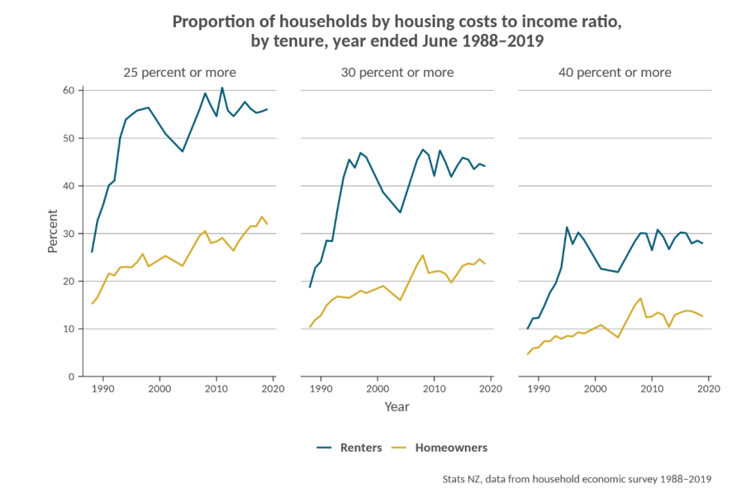
Why should we care about rents?
More people are renting (privately)
Renters are more vulnerable to large movements in housing costs
Rents provide a better signal of the balance of dwellings supply and demand than house prices
Better forecast of rents can also lead to better forecast of house prices

Slide 8
Potential factors
Wages
Physical supply and demand of dwellings (measured by people per dwelling)
Mortgage (interest) rates
General inflation
Unemployment rate/job security
House prices

Slide 9
Key findings
Wage inflation and relative supply and demand of dwellings are the two key drivers of rents at the national level
Increasing mortgage rates increases rents and increasing unemployment decreases rents but the impacts are relatively weak
Wages and relative supply demand of dwellings are also key drivers of rents at the regional level, although unobserved region-specific factors can dampen or magnify these effects

Slide 10
Key findings in numbers
All else equal, a 1 per cent increase in nominal wages leads directly to 1 per cent increase in new tenancy rents
A 1 percent increase in the number of people per dwelling leads to a 1.5 percent increase in new tenancy rents

Slide 11
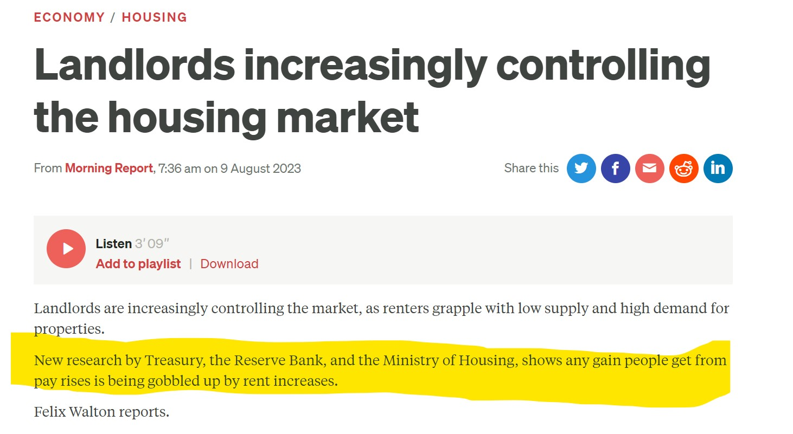
Media coverage
Renters only pay a proportion of their income on rents
The 1 to 1 relationship between wages and rents does not mean all the dollars of tenants’ wage gains go straight into rents

Slide 12
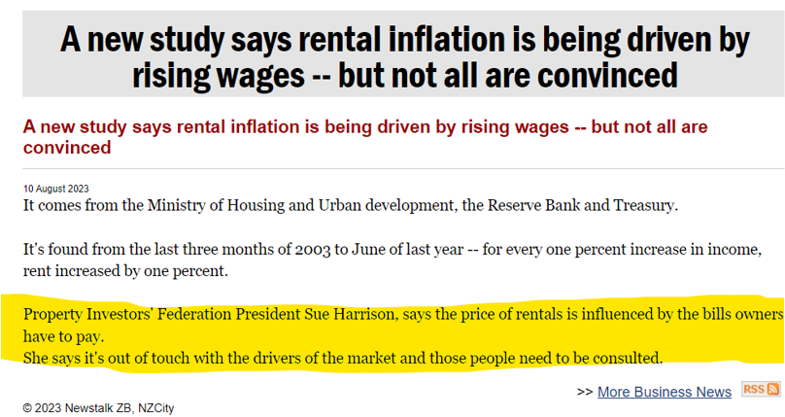
Media coverage
Historically mortgage costs have not always moved with rents

Slide 13
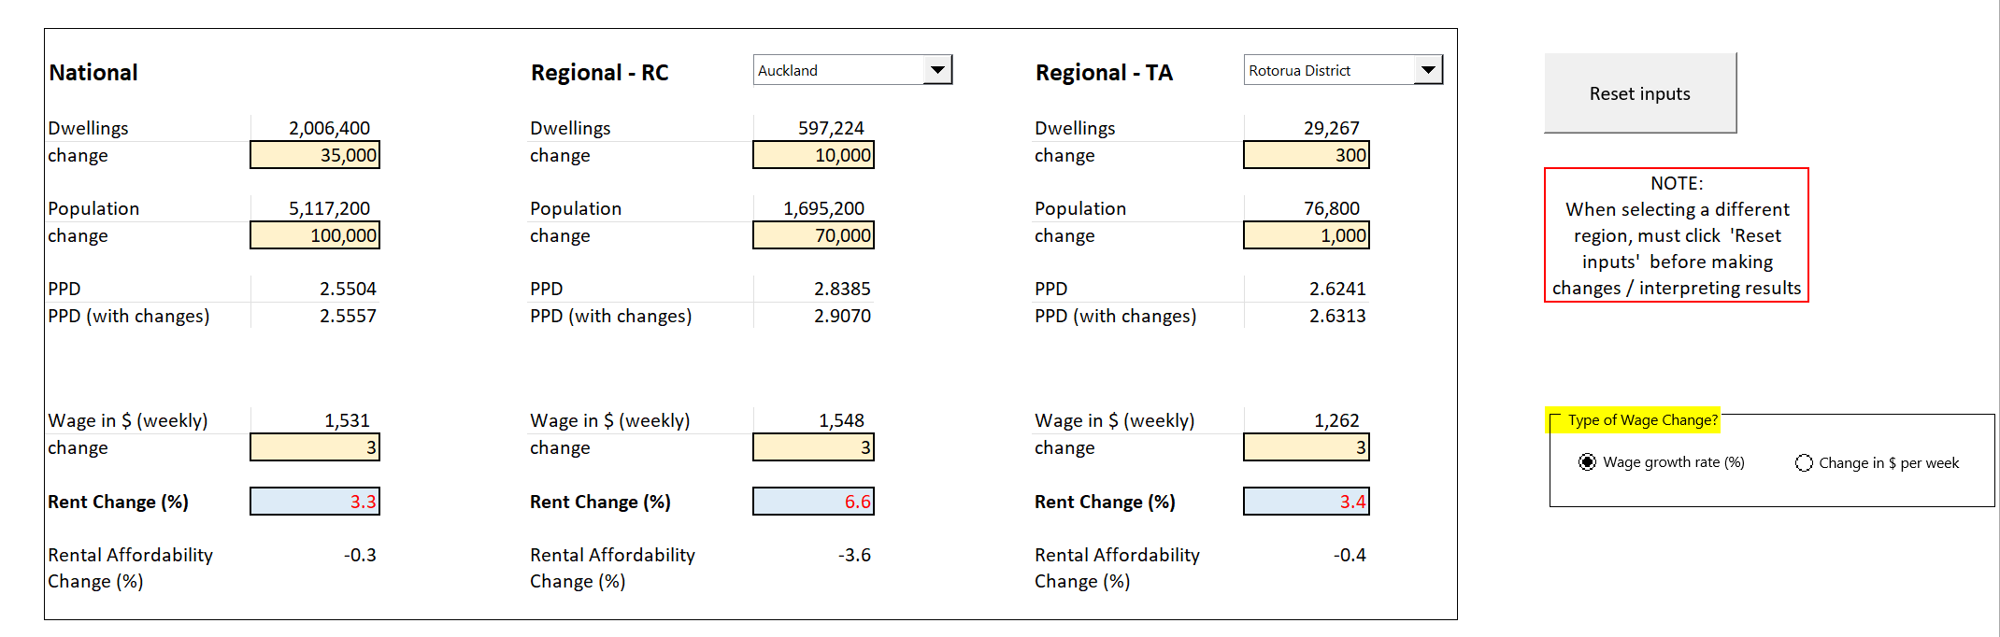
Rents drivers tool

